Slide 1
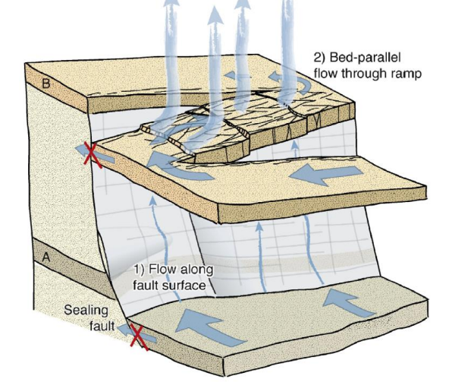
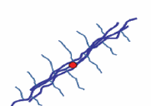
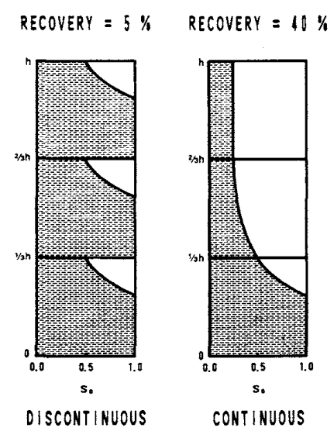
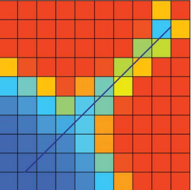
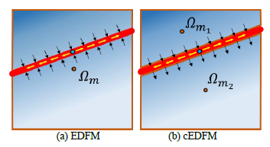
Pros and Cons of Discrete Fracture Models Renato Poli
Objectives
Investigate the state of the art of discrete fracture models (EDFM, Dual-porosity/permeability, DFN, XFEM, Phase-field, etc)
Direct upcoming research to cover the most important issues
Approach
Critical review of the history of fracture models, recent developments, and unaddressed problems
Key findings
We acknowledge the progress observed, with EDFM playing an important role, and thermo-mechanical integration
HF vs NF: the cubic law and aperture-based models are misleading;
Workflows must consider uncertainties and fast optimization loops
There is room to improve the characterization of multiphase flow, capillary continuity, and upscaling of the fracture network
Benchmarks are not well established for NF simulation
(Oliveira, 2019)
(Farah, 2014)
(Moinfar, 2013)
(Horie, 1990)
(Chai, 2018)

